Slide 1








Rugged Monitoring designs, manufactures and commercializes rugged fiber optic temperature sensors and monitors for laboratories, utilities, industrial, process, medical and OEM applications.

Slide 2

Rugged Monitoring
Vision
Be first in mind and choice for customers by delivering leading edge, innovative and reliable monitoring solutions
Mission
Leading provider in fiber optic based sensing solutions dedicated to offering the best in class reliability & service.
Commitment
Reliable, high performance, precision, rugged customizable sensors and monitoring solutions

Slide 3
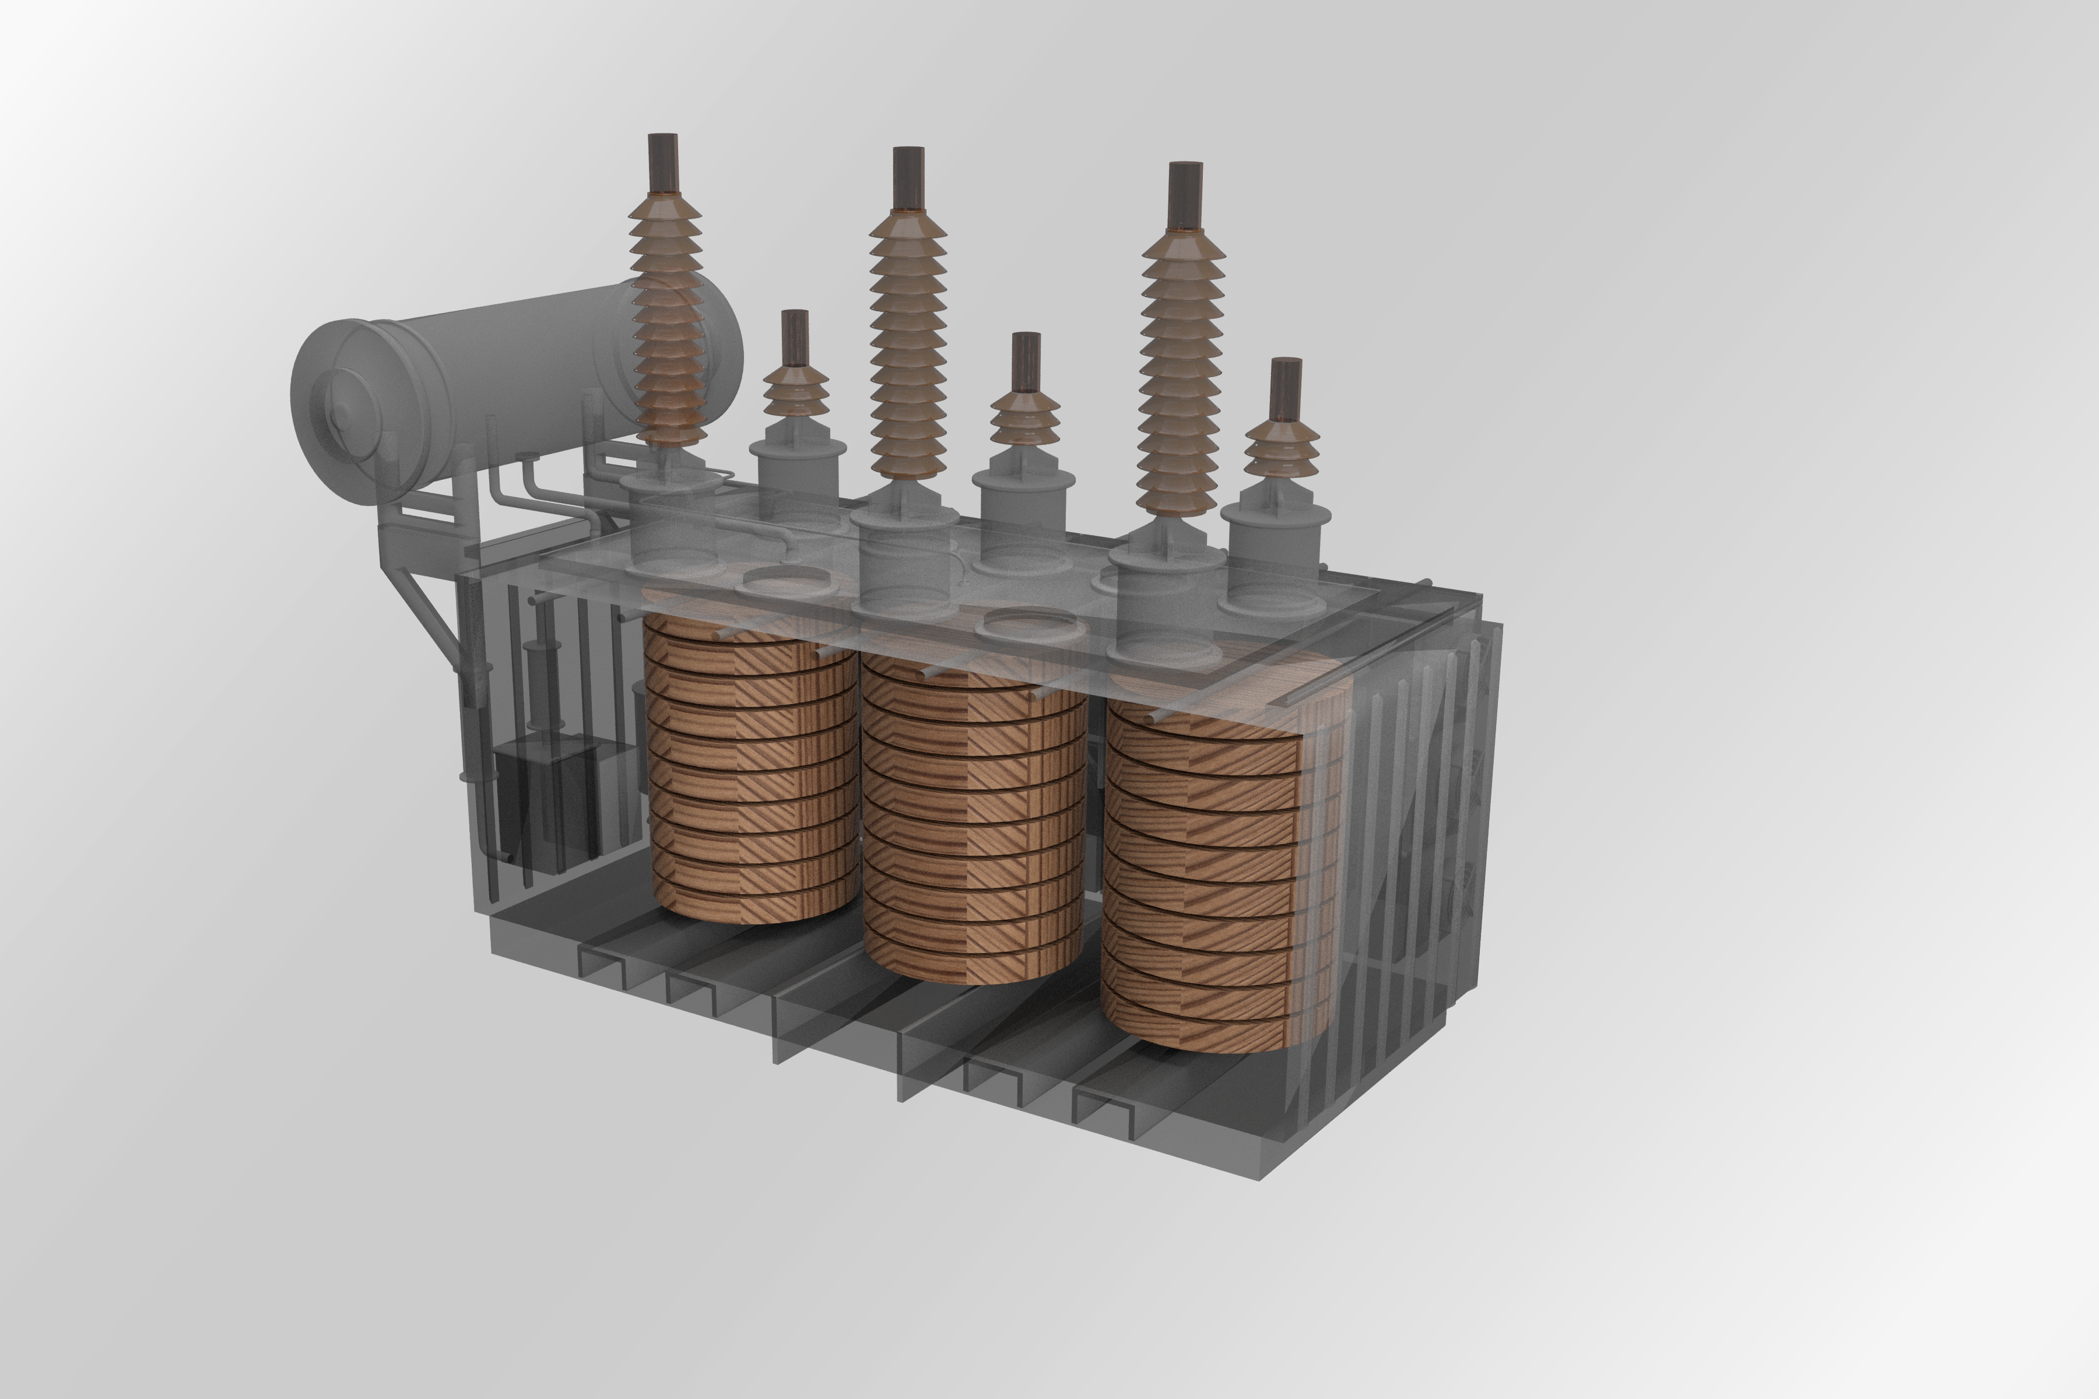


Our Plan
Be a leading fiber optics based sensing solution provider to Utilities , E- Mobility and Medical industry verticals
Energy/ Utilities
E-Mobility
Medical

Slide 4



Industries We Serve
Utilities
E-Mobility
Medical
Industrial
Research Lab
RF / Microwave

Slide 5
Our Plan
Utilities
E-Mobility
Sensing Solutions:
Medical
Near Term
Mid term
GaAs Temperature
Fluorescence Temperature
GaAs Temperature
Fluorescence Temperature
GaAs Temperature
Initial Focus
Pressure
Vibration
Partial Discharge
Light
FBG Temperature
Pressure
Vibration
Fabry-Pérot Pressure
Fluorescence Temperature

Slide 6
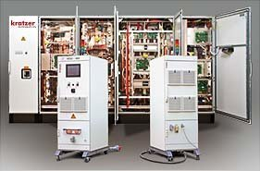
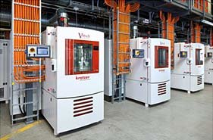
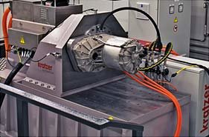
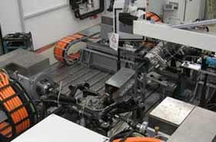
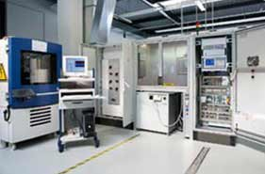
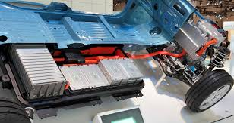


E-Mobility Plan
Sensing Solutions for:
Battery Simulation
Battery Test Stands
Motor Testing
Power Train Testing
Power Electronics
Li-ion Battery packs
Power Cables
Fast Chargers
Leading Temperature, Pressure, Vibration, Partial discharge sensing solutions for E-Mobility segments that are undergoing major design transformations with EV’s.

Slide 7
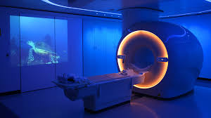
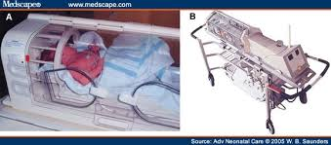

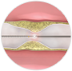

Medical Plan
Sensing Solutions for:
Equipment
Neo natal
Clinical Trials
Interventional
Power Electronics
Bio Medical
Leading Temperature, Pressure, Vibration sensing solutions for Medical segments that are undergoing next generation transitions.

Slide 8
Presentation Outline, with Focus on Transformer Applications
Rugged Monitoring Products
Importance of Transformer Hotspot Monitoring
Traditional Measurement Methods
Fiber Optic Temperature Measurement Advantages
Fiber Optic Measurement Equipment
Recommendations on Probe Installation

Slide 9
Presentation Outline
Rugged Monitoring Products and Applications
Importance of Transformer Hotspot Monitoring
Traditional Measurement Methods
Fiber Optic Temperature Measurement Advantages
Fiber Optic Measurement Equipment
Recommendations on Probe Installation

Slide 10
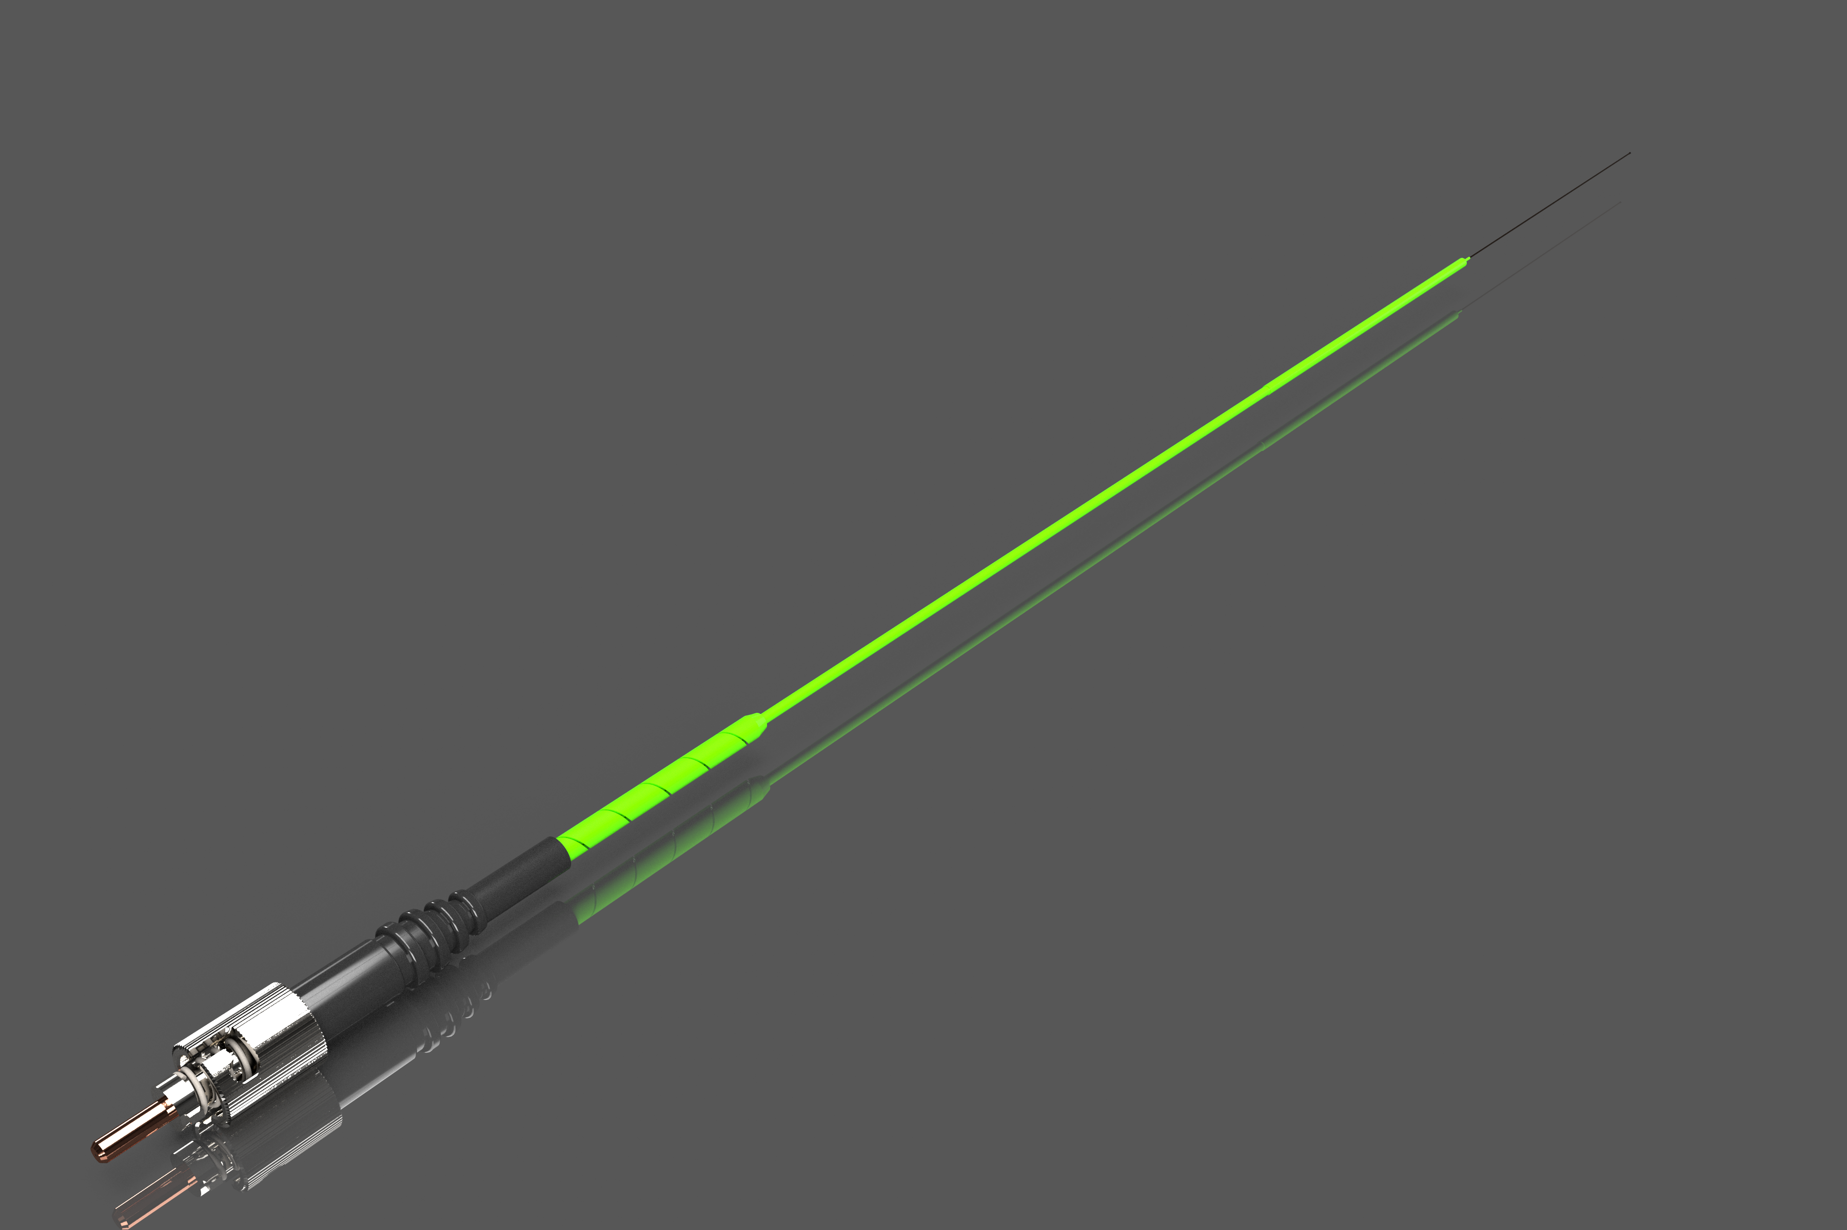
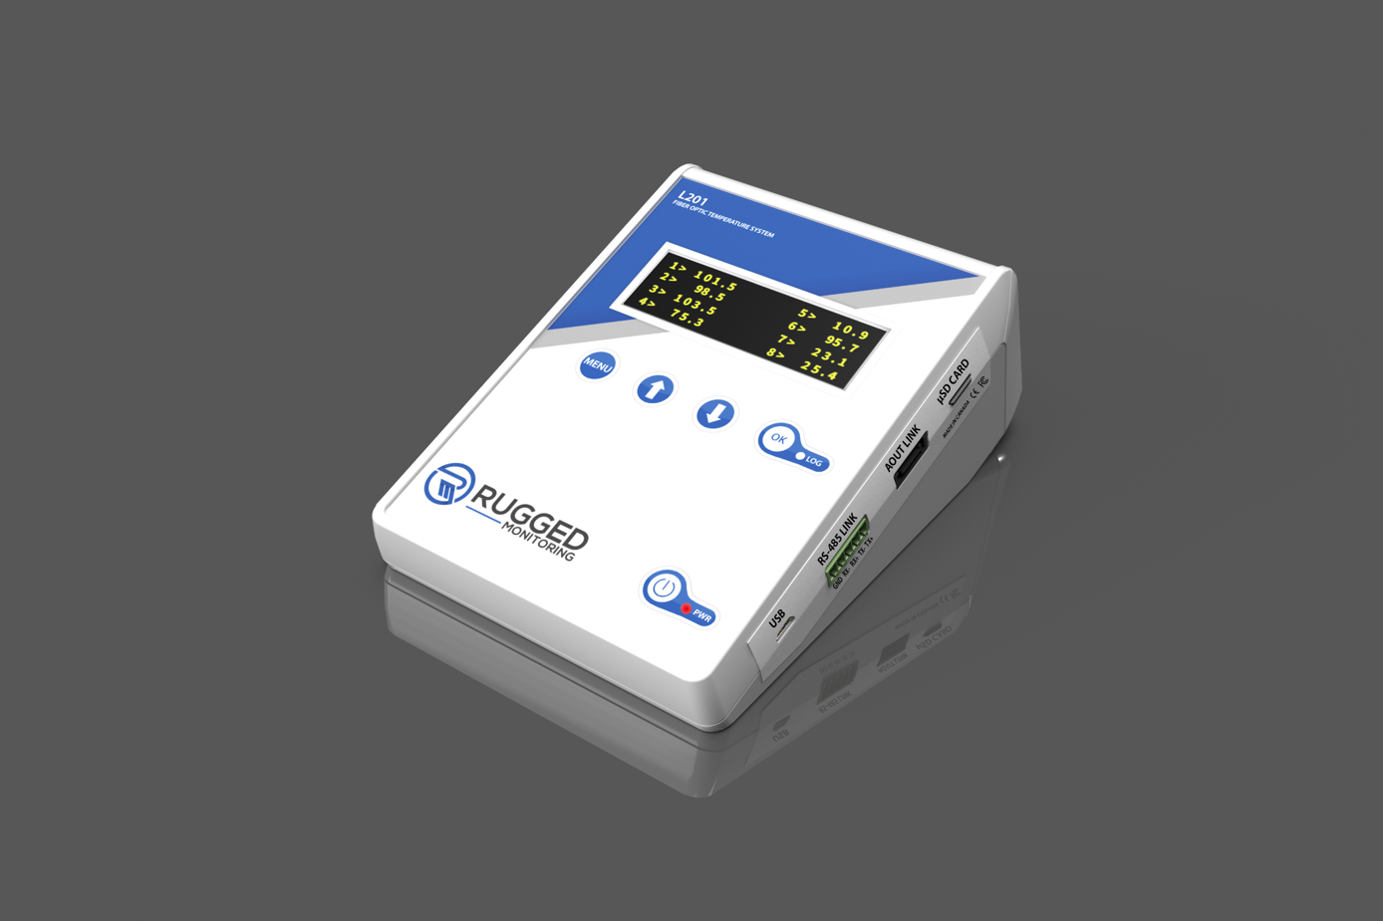
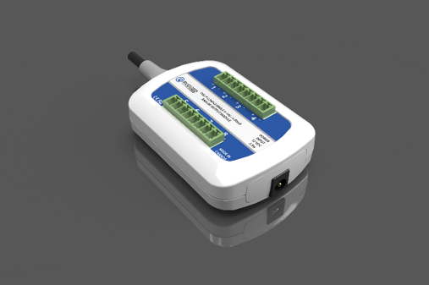
Fiber Optic Sensors
Products
Monitors
Accessories & Software

Slide 11
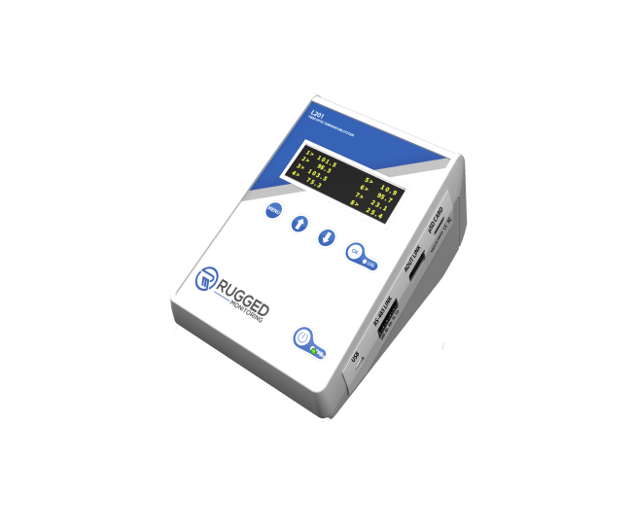
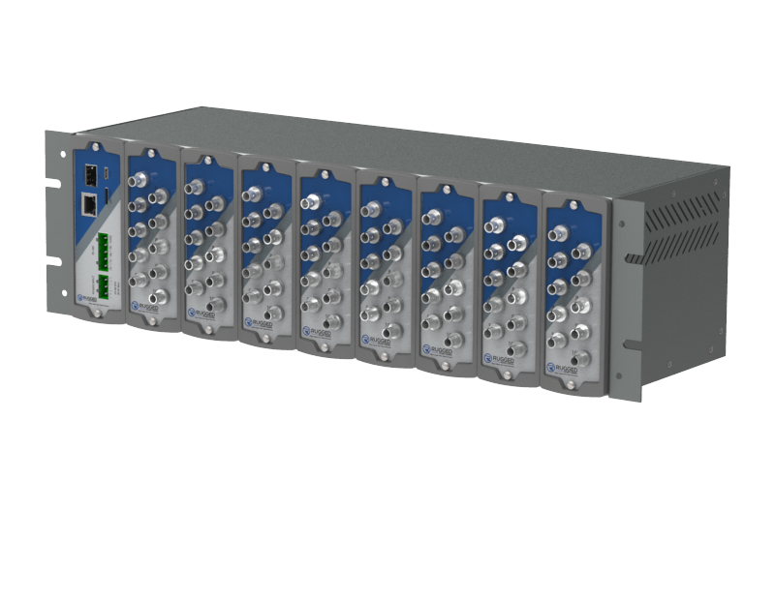
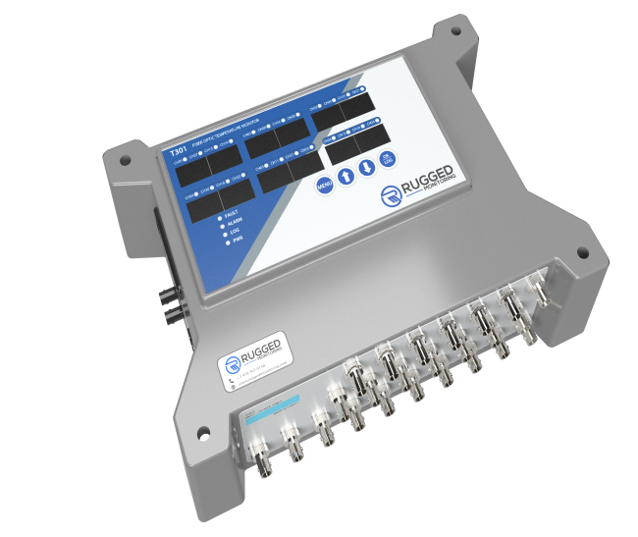
Products Range
T301
Continuous Monitoring
4-24 Channels
L201
R501
R&D Applications
2-8 Channels
Rack Mount
8-256 Channels

Slide 12
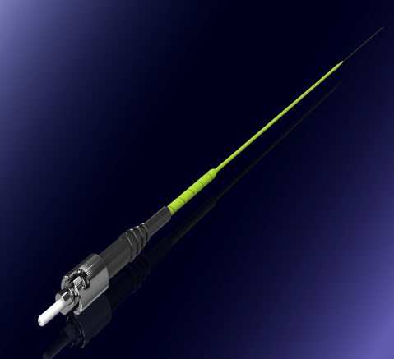
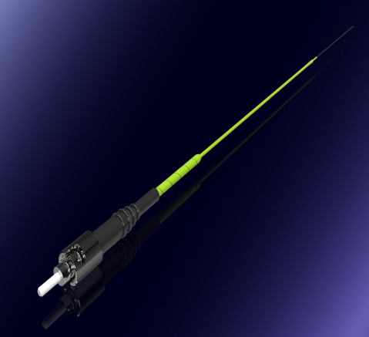
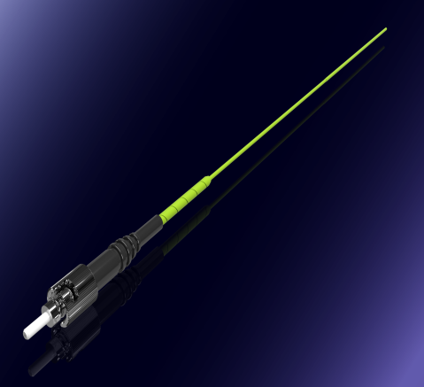

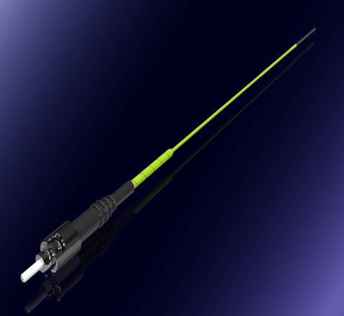

Sensors Range
Lsens B
Lsens R
Tsens
Medical
0.3 mm Dia
Industrial
1.7 mm Dia
Hot Spot, Transformers
3 mm Dia
Lsens C
Lsens P
Lsens T
Cryogenic
As low as 4°K
Electric Vehicle
0.7 mm Dia
Chemical
1.1 mm Dia

Slide 13





Immunity to Environments
Radiation
Radio Frequency
Chemicals
High voltage
Microwave
13

Slide 14







Advantages
Point Measurement
Unbeatable Price / Value
Rugged Sensors
No Calibration
Water Proof Sensors
Designed for Temperature
48 hours Service Response

Slide 15
Applications
Transformer Hot Spot Monitoring
MW oven design and testing
Microwave Chemistry
Electric Vehicle & Battery Testing
OEM integration with MW manufacturers
Sterilization, Pasteurization Process

Slide 16
Applications
Medical Equipment Manufacturers
R&D Labs
Cryogenics
PCB Development & Testing
Process Industries
Food & Beverage

Slide 17
Presentation Outline
Rugged Monitoring Products and Applications
Importance of Transformer Hotspot Monitoring
Traditional Measurement Methods
Fiber Optic Temperature Measurement Advantages
Fiber Optic Measurement Equipment
Recommendations on Probe Installation

Slide 18
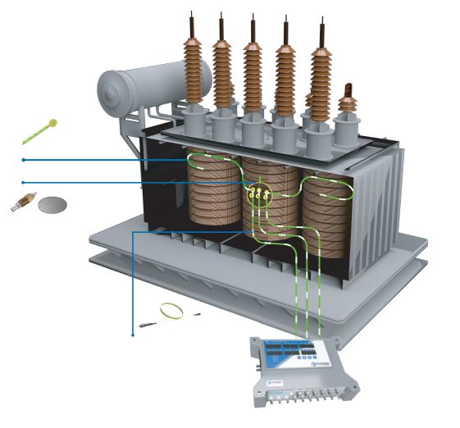
Transformer Hot Spot Monitoring System Diagram
Tsens Transformer Sensor
Feedthroughs
Tank Wall Plate
Fiber Optic Extension Cable
T301 Monitor

Slide 19
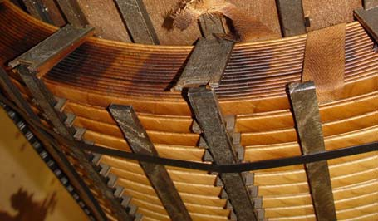
Importance of Hot Spot Monitoring
To assess the insulation aging rate and resulting remaining life
Rationale: Winding temperatures have a direct impact on insulation aging
To maximize the load potential safely
Rationale: Winding temperatures limit the load potential
To better manage assets and drive revenue generation strategies
Normal Kraft paper
Thermally Upgraded Paper

Slide 20
Presentation Outline
Rugged Monitoring Products and Applications
Importance of Hotspot Monitoring
Traditional Measurement Methods
Fiber Optic Temperature Measurement Advantages
Fiber Optic Measurement Equipment
Recommendations on Probe Installation

Slide 21
Traditional Measurements – WTI

Slide 22
Limitations of Traditional Measurements, with WTI’s
Regardless of the sophistication level of Modern WTI’s (some have microprocessors to calculate), they still simulate or approximate the real temperatures present in the windings
The time response of WTI’s is based on oil time constant, not winding’
WTI’s are rarely calibrated correctly
Theory says that they can be calibrated only if fiber optic sensors are used to validate them
Display errors of 5 to 10 degrees C, or more, are common

Slide 23
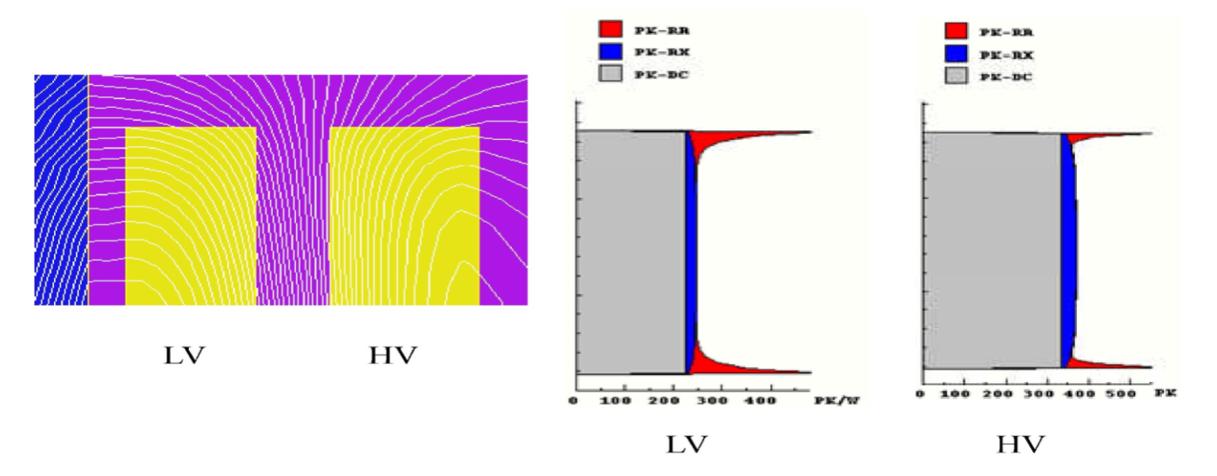
Traditional Measurements – Heat Run Tests
“Heat Run” tests reveal average winding temperature under rated load
What is of interest for insulation aging is the winding hottest spot temperature (temperature is not uniform around the winding)
Temperature is highest at top of winding
Oil is hotter
Stray losses in winding are higher
Winding insulation often calls for more paper to provide better insulation against voltage surges
Radial Eddy Loss
Axial Eddy Loss
DC losses (Loss = RI²)
●
●
Top of winding
Core
Bottom of winding

Slide 24
Traditional Measurements – Model
Top-Oil Temp.
Hot-Spot Temp.
Top Oil Temp.
Hot-Spot Rise
Hot Spot Temp.
Oil
Winding
Average Winding Temp.
Temperature (
o
C)

Slide 25
Winding Hotspot Temp Model
For any load level, the hottest winding temperature is assumed to be:
Winding hot-spot temp.
=
Top-Oil Temp.
+
Hot-spot rise at rated load
* (%Load)^{2m}
For several decades, this method was a standard feature:
IEEE C57.91 - 1995 “IEEE Guide for Loading Mineral Oil Immersed Transformers”
IEC 60354 - 1991 “Loading Guide for Oil-Immersed Power Transformers”
This simplified method is now regarded as inadequate to estimate the aging of transformers given increasing occurrences of overloads
IEEE and IEC are proposing new methods to take account of (neglected in the previous equation):
True oil temperature in the cooling duct
Change in winding resistance with temperature
Change in oil viscosity with temperature
The effect of tap changers
Oil inertia in case of sudden overload of large magnitude

Slide 26
Presentation Outline
Rugged Monitoring Products and Applications
Importance of Hotspot Monitoring
Traditional Measurement Methods
Fiber Optic Temperature Measurement Advantages
Fiber Optic Measurement Equipment
Recommendations on Probe Installation

Slide 27
Winding Hot Spot Temperature Model
The evolution in calculation methods indicates:
Methods used until now are not very accurate
New methods will require additional parameters that are not always readily available
New models still rely on information provided by the transformer manufacturer and not always validated
Accurate hot spot temperature knowledge allows for better estimation of transformer MVA performance.
Direct Measurement of Winding Temperature with Fiber Optic Sensors is Recognized as the Best. method

Slide 28
Presentation Outline
Rugged Monitoring Products and Applications
Importance of Hotspot Monitoring
Traditional Measurement Methods
Fiber Optic Temperature Measurement Advantages
Fiber Optic Measurement Equipment
Recommendations on Probe Installation

Slide 29

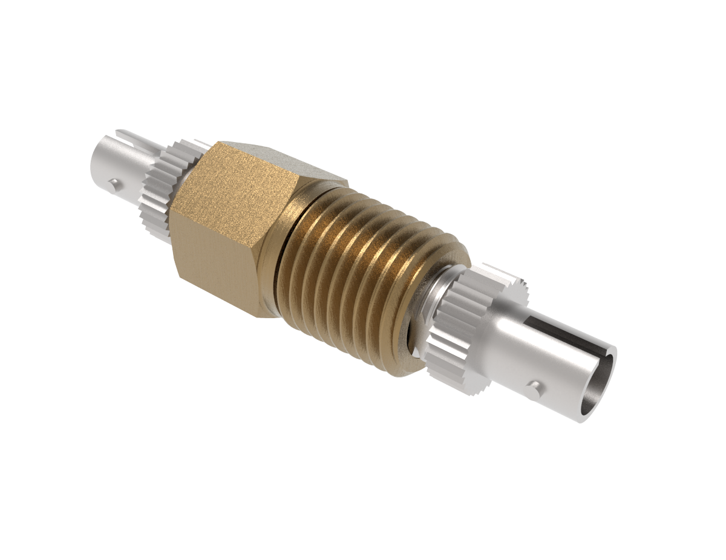
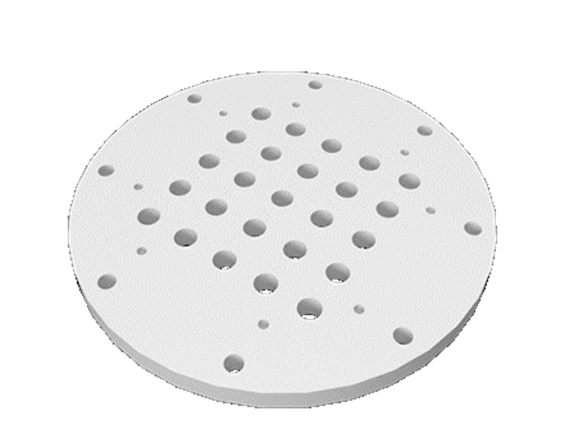
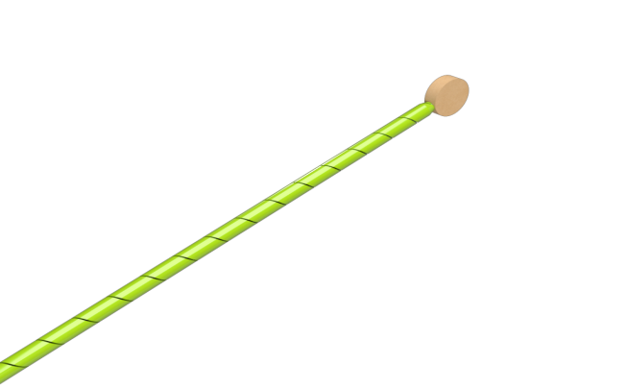
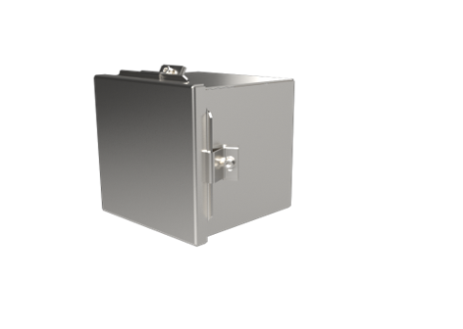
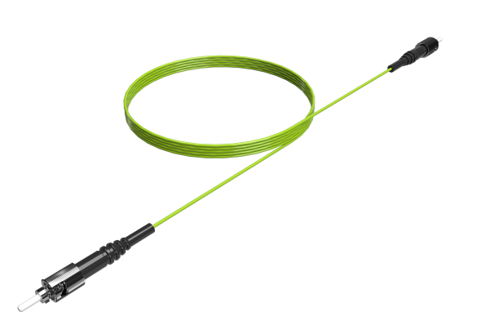
Monitor & Accessories
T301 Monitor
Tank Wall Plate
Feedthrough
Tsens Probe
Interface Box
Extension Cable

Slide 30
Specifications
Accuracy of ±1 °C, resolution of 0.1 °C
“Optical System Integrity Check” feature
Rugged and sturdy cast aluminum construction
One monitor supports up to 24 optical temperature sensors
8 channel fully programmable analog outputs, V or mA
8 programmable Form-C relays (5A)
Dedicated system fault relay
Based on market leading GaAs technology for long term reliability
Light sources have an estimated life of 300 years
Environmental temperature range: -40 to +72 ºC
8 GB memory industrial grade removable microSD card (option)
Enough for at least 10 years of data, @10sec rate
Built in Webserver, with 1 Gigabit Optical Ethernet (option)
Standard USB and serial RS-485 interfaces (with Modbus, DNP3 and IEC 60870-5-101)
24 or 48 VDC, ~ 20 watts
Full set of advance communication protocols
IEC 61850, Modbus over Ethernet, DNP3 and IEC 60870-5-104
Optional fiber SFP transceiver, an industry standard
Benefit: Redundant Ethernet communication
T301 Monitor
A Rugged Monitoring first:
An internal reference optical sensor
insures optical module integrity

Slide 31
Monitor / Software – Features
T301 Monitor
4 - 24 Channels
Onboard Data logging, on microSD
Industrial grade Electronics
Gigabit Optical Ethernet option
Analog output option (8 outputs)
Industry standard protocols
Designed for harsh environments
0.1 °C Resolution
Built in Webserver (with Ethernet)
Built in Optical Integrity Check
Rugged Connect Software
Single Suite for all devices
Designed for Periodic and Continuous Monitoring
Easy to use Analytics
Export Data for Analysis
LabVIEW / MATLAB / Python Drivers
Proprietary Algorithms
Customizable for System integration
Can generate configurations for virtual instruments

Slide 32
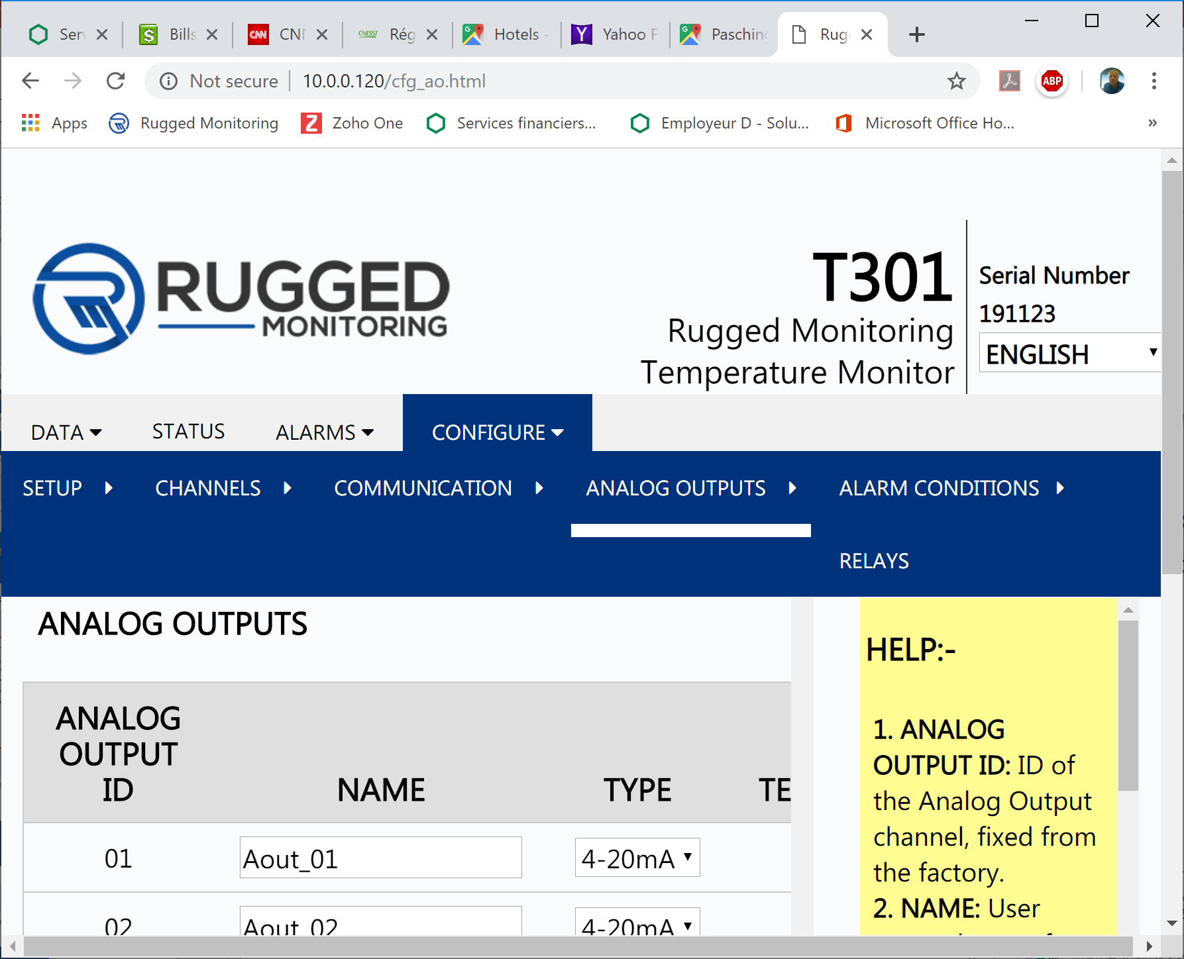
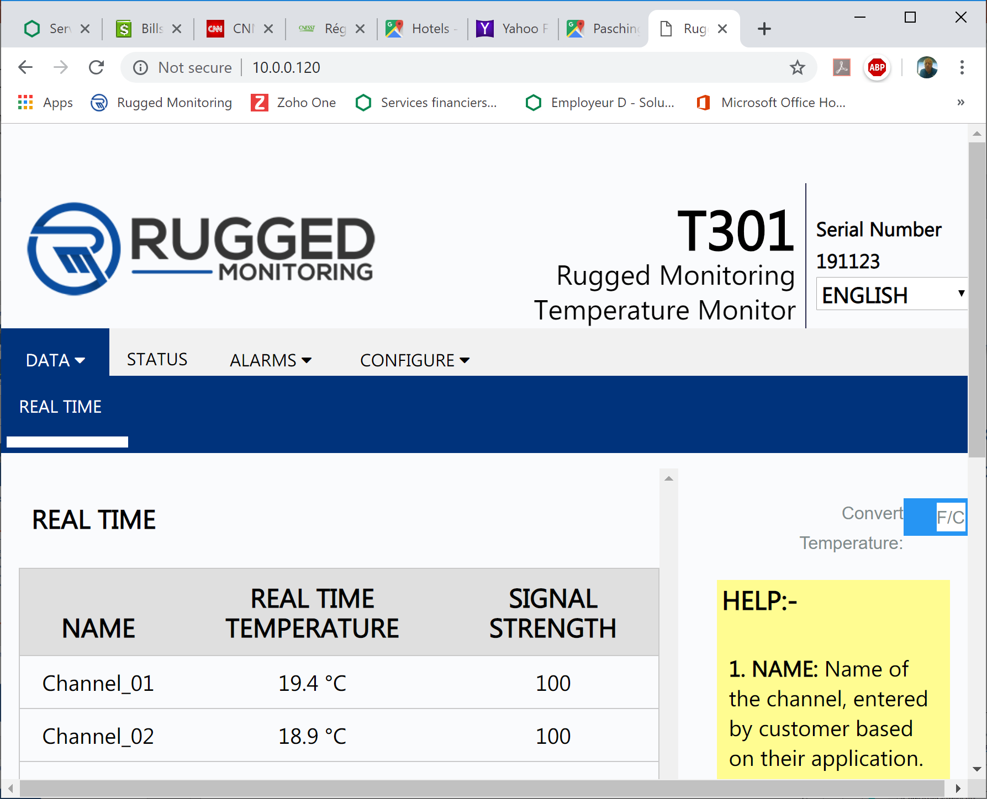
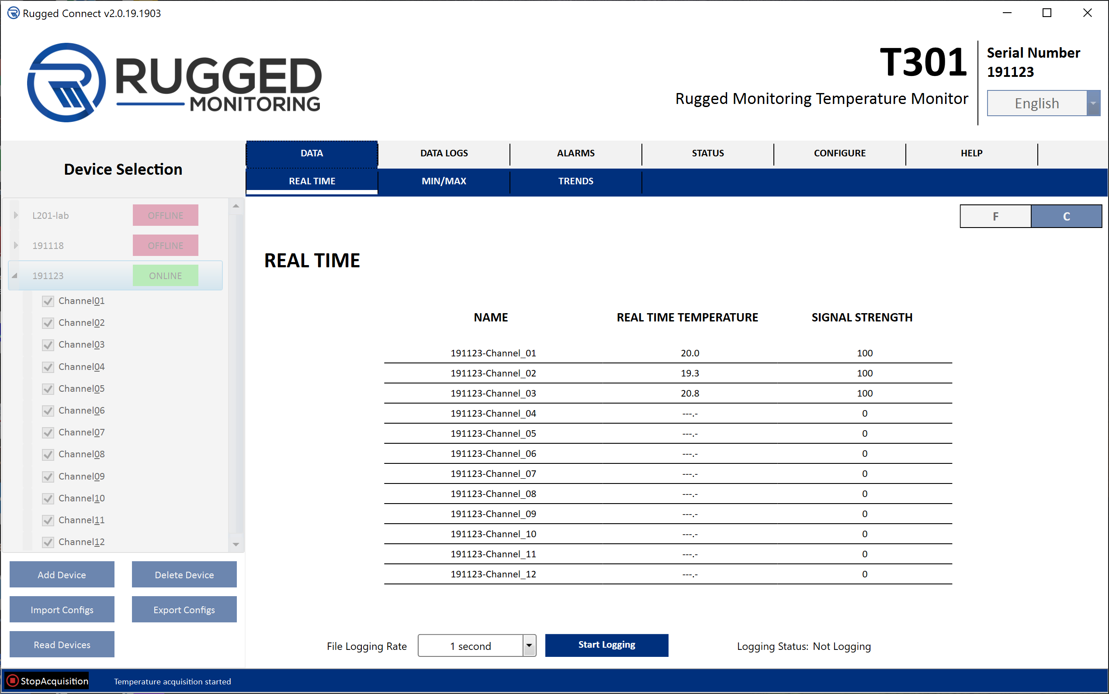
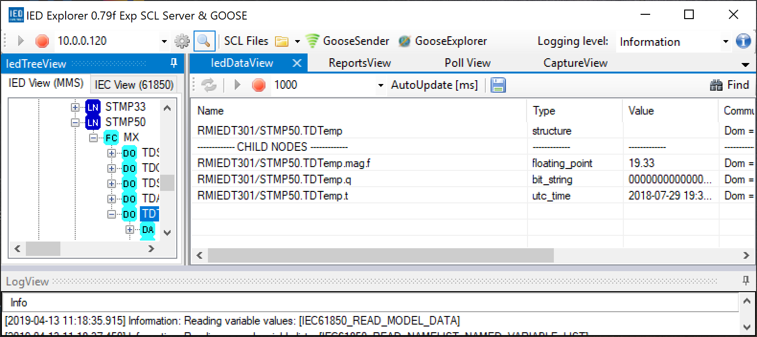
T301 Monitor Software – User First – Ease of Use
Rugged Connect
Webserver /Ethernet
Supports up to 4 instruments
Each with its own USB interface
Supports all popular serial protocols
Modbus, DNP 3 and IEC 60870-5-101
Data logging and graphing
Supports virtual instruments (re projects)
Similar “Look & Feel” as Rugged Connect
Supports all popular Ethernet protocols
Modbus, DNP 3, IEC 60870-5-104 & IEC 61850

Slide 33

Transformer Sensors (Tsens)
Specifications
Improved design (patent pending)
Measuring range: -80 °C to 250 °C
Response time of ~1 sec
Available in any lengths, up to 25 m (or more)
With industry standard ST connector, with zirconia ferrule
Solid Torlon disc tip, diameter 9 mm (patent pending)
Features
Suitable for dry-type and oil-filled transformers
Compatible with all types of transformer oil, including ester type
Meets and surpasses ASTM D3426 and D-149 standards
Extremely low PD performance (< 2pC)
Very high resistance to pulling (> 60 N)
Compatible with kerosene vapor drying process
With or without disc tip
Disc version recommended for all applications
Patent Pending

Slide 34
Feedthrough
Specifications
With zirconia connectors for better optical light transmission
Stainless steel 316L construction
Standard ¼” NPT
Other sizes also available
Wide temperature and pressure ranges
Features
Easy installation
No O-rings design
Tested to 10,000 psi

Slide 35

Extension Cable
Specifications
With zirconia connectors (ferrules)
3 mm OD
Maximum temperature: +85 °C
Available in any lengths, up to 99 meters
Features
PVC sheathing with Kevlar reinforcement
Dielectric Torlon connectors available

Slide 36
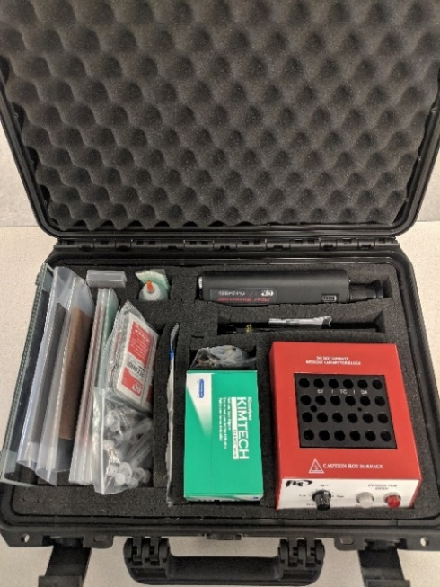
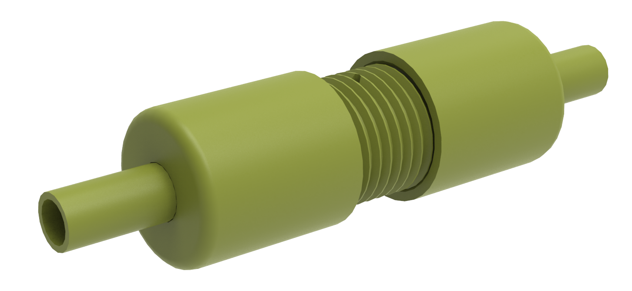
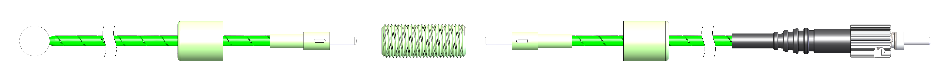
Dielectric Connector
Specifications
With zirconia connectors for better optical light transmission
Torlon construction
Entirely dielectric design
Repair kit is available
Features
Best to repair damaged probes in the field
Can also be used to extend already installed probes that are found to be too short

Slide 37
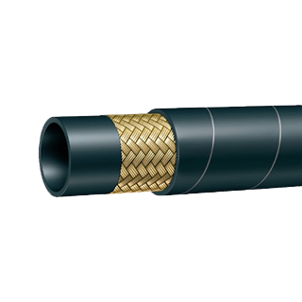
Extension Bundle
Specifications
17 mm OD
For up to 24 fibers
Fanouts of 50 cm at each end
Steel reinforced
Maximum temperature: +100 °C
Available in any lengths, up to 25 meters, or more

Slide 38
Tank Wall Plate & Interface Box
Specifications
Features
Diameter of 275 mm
Stainless steel 316L construction
For up to 25 feedthroughs
With O-Ring or gasket
Gasket is customer supplied
Compatible with Interface I-Box
Optional bolting provision
Tank Wall Plate
Specifications
Features
Size 200 x 200 mm, 150 mm high
With neoprene gasket
Stainless steel 316L construction throughout
Leak proof design
Meet IP66 rating
Interface Box

Slide 39
Fiber Optic Temperature Sensors
RUGGED MONITORING
Intrinsically safe
Immunity to Magnetic and RF Fields
Customizable to every need
Harsh environments
Highly Corrosive applications

Slide 40
Presentation Outline
Rugged Monitoring Products and Applications
Importance of Hotspot Monitoring
Traditional Measurement Methods
Fiber Optic Temperature Measurement Advantages
Fiber Optic Measurement Equipment
Recommendations on Probe Installation

Slide 41
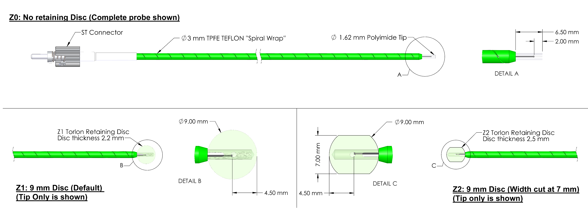
Recommendations on Probe Installation – 1
Details of probe construction

Slide 42
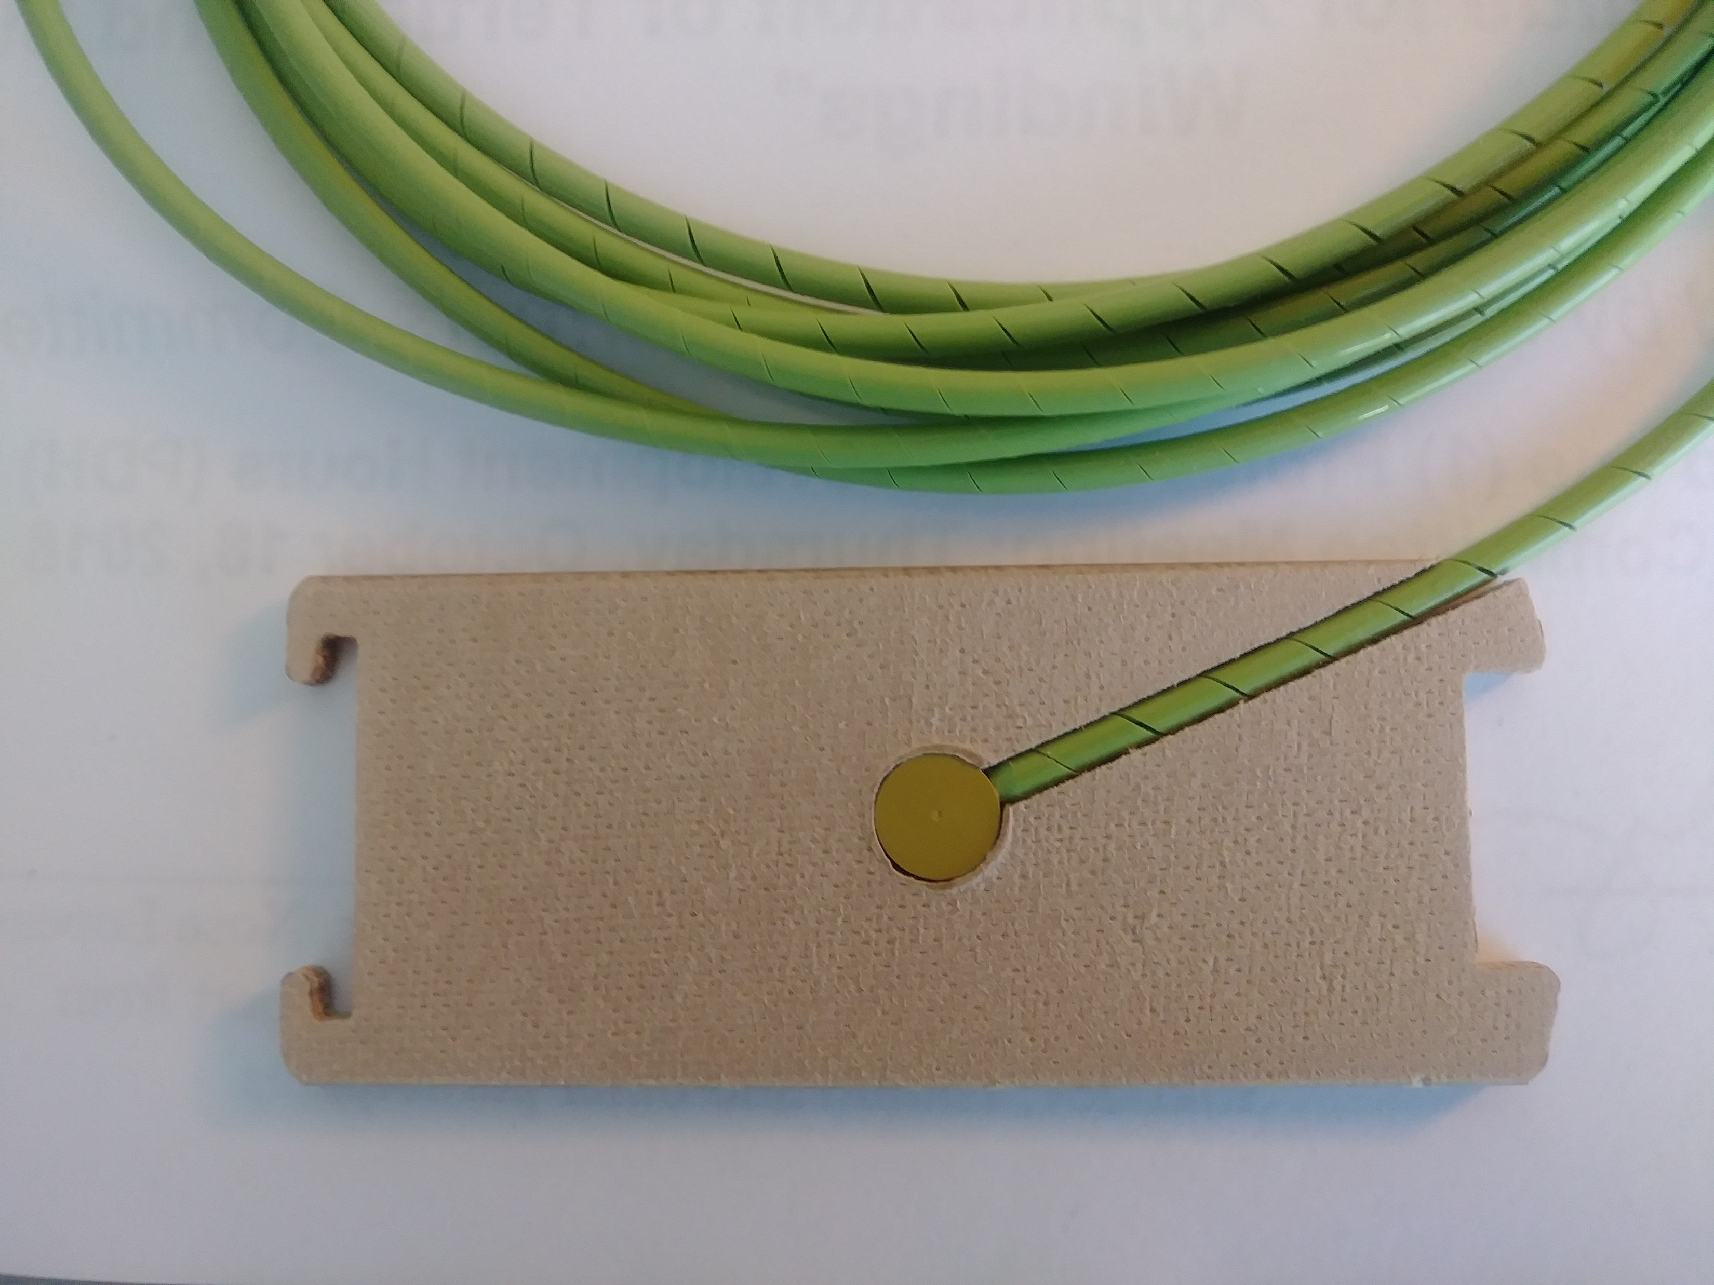
Recommendations on Probe Installation – 2
Recommendations:
Probe with disc option (9 mm) is recommended for ALL applications
Always mount probes in pressboard material, 3 mm thick or more
Unless you want to measure oil temperature, make sure sensor is not in direct contact with circulating oil
Try to minimize the number of bends, with minimum bending radius of 5 cm or more
If you need to coil extra length of probe cable, make sure coil diameter is at least 30 cm.

Slide 43
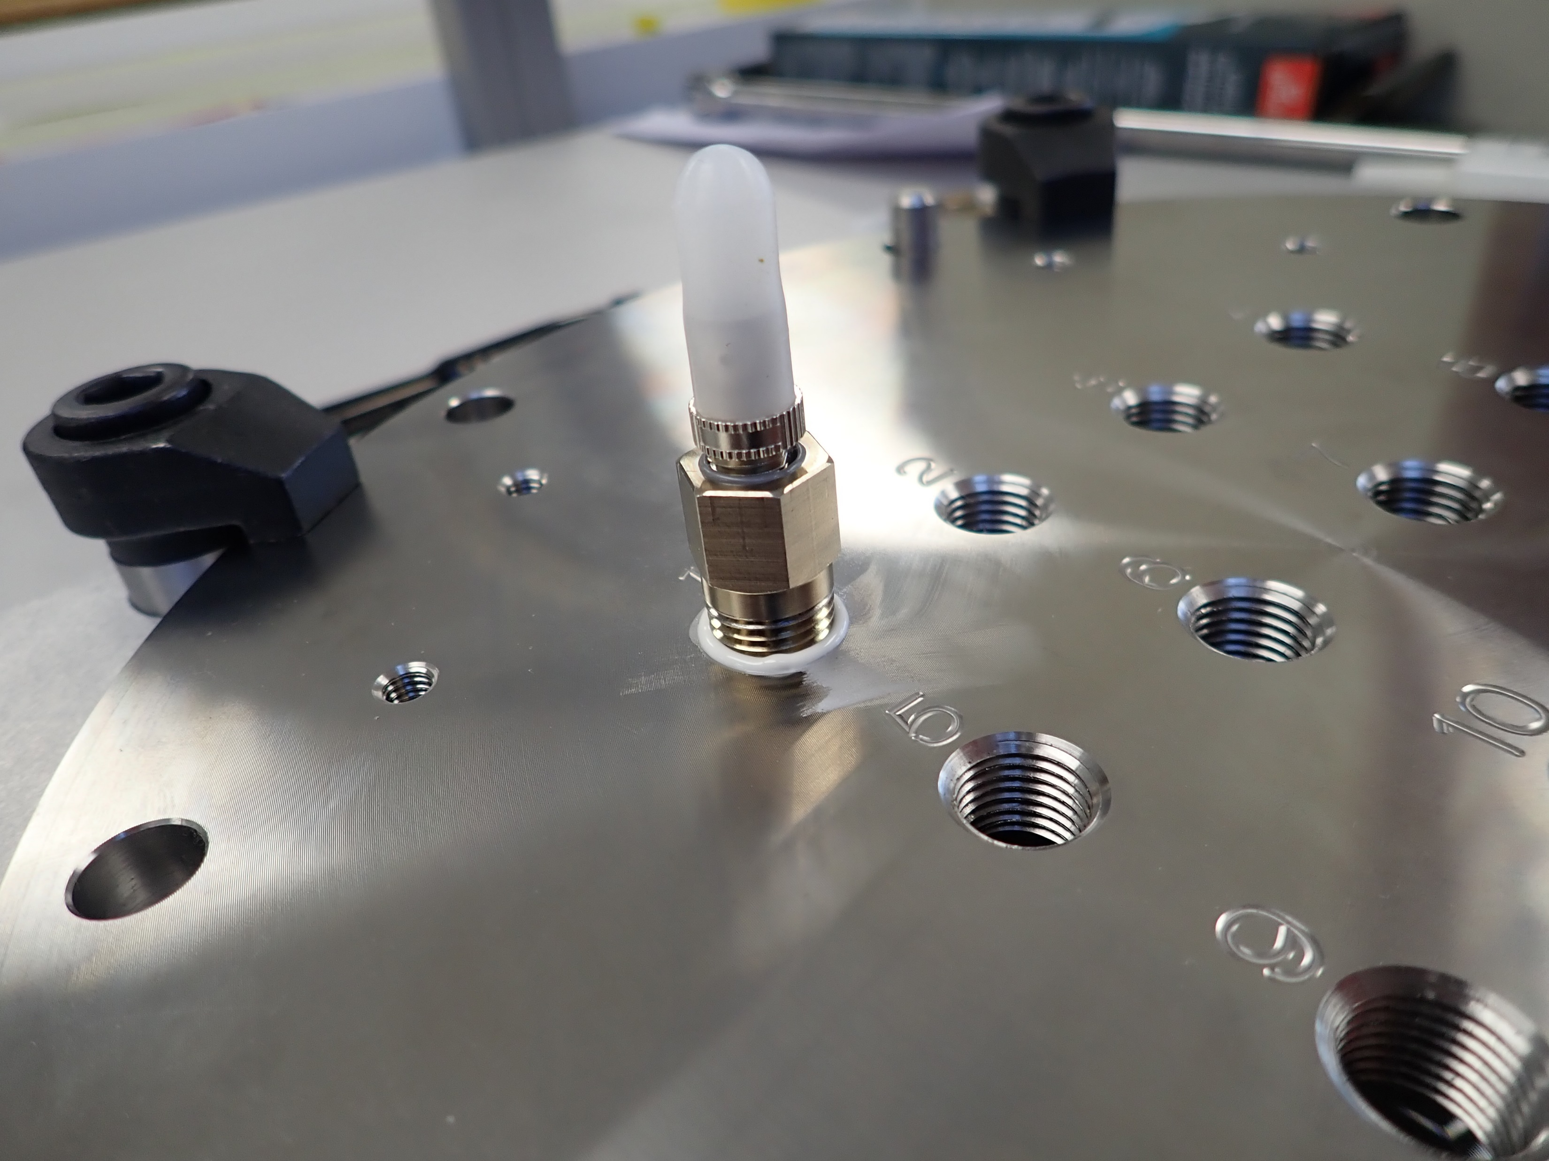
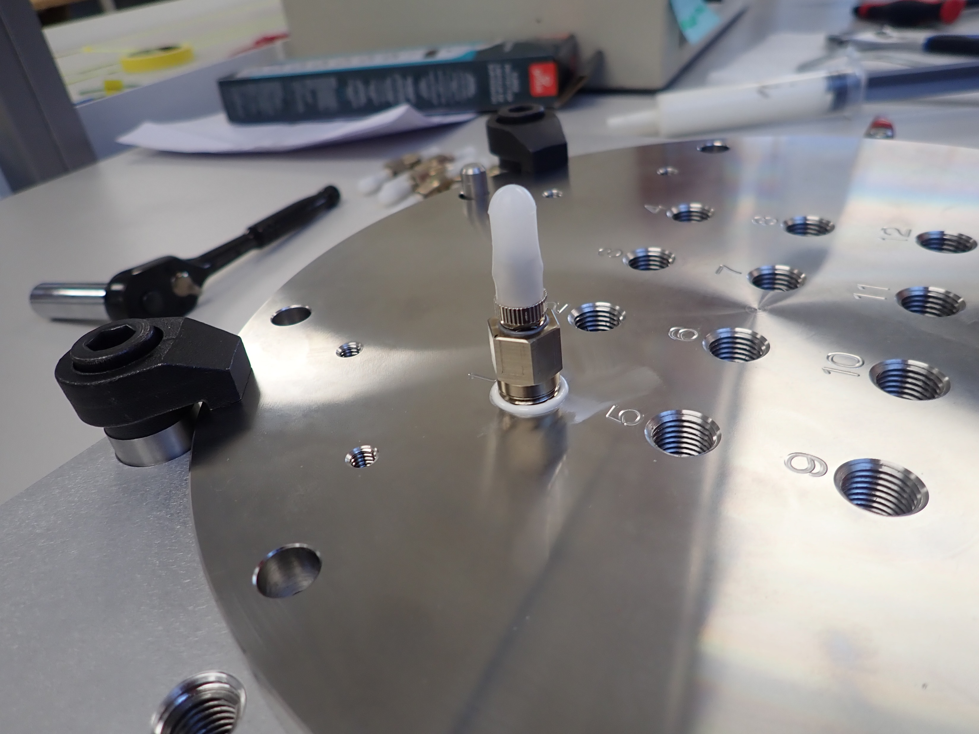
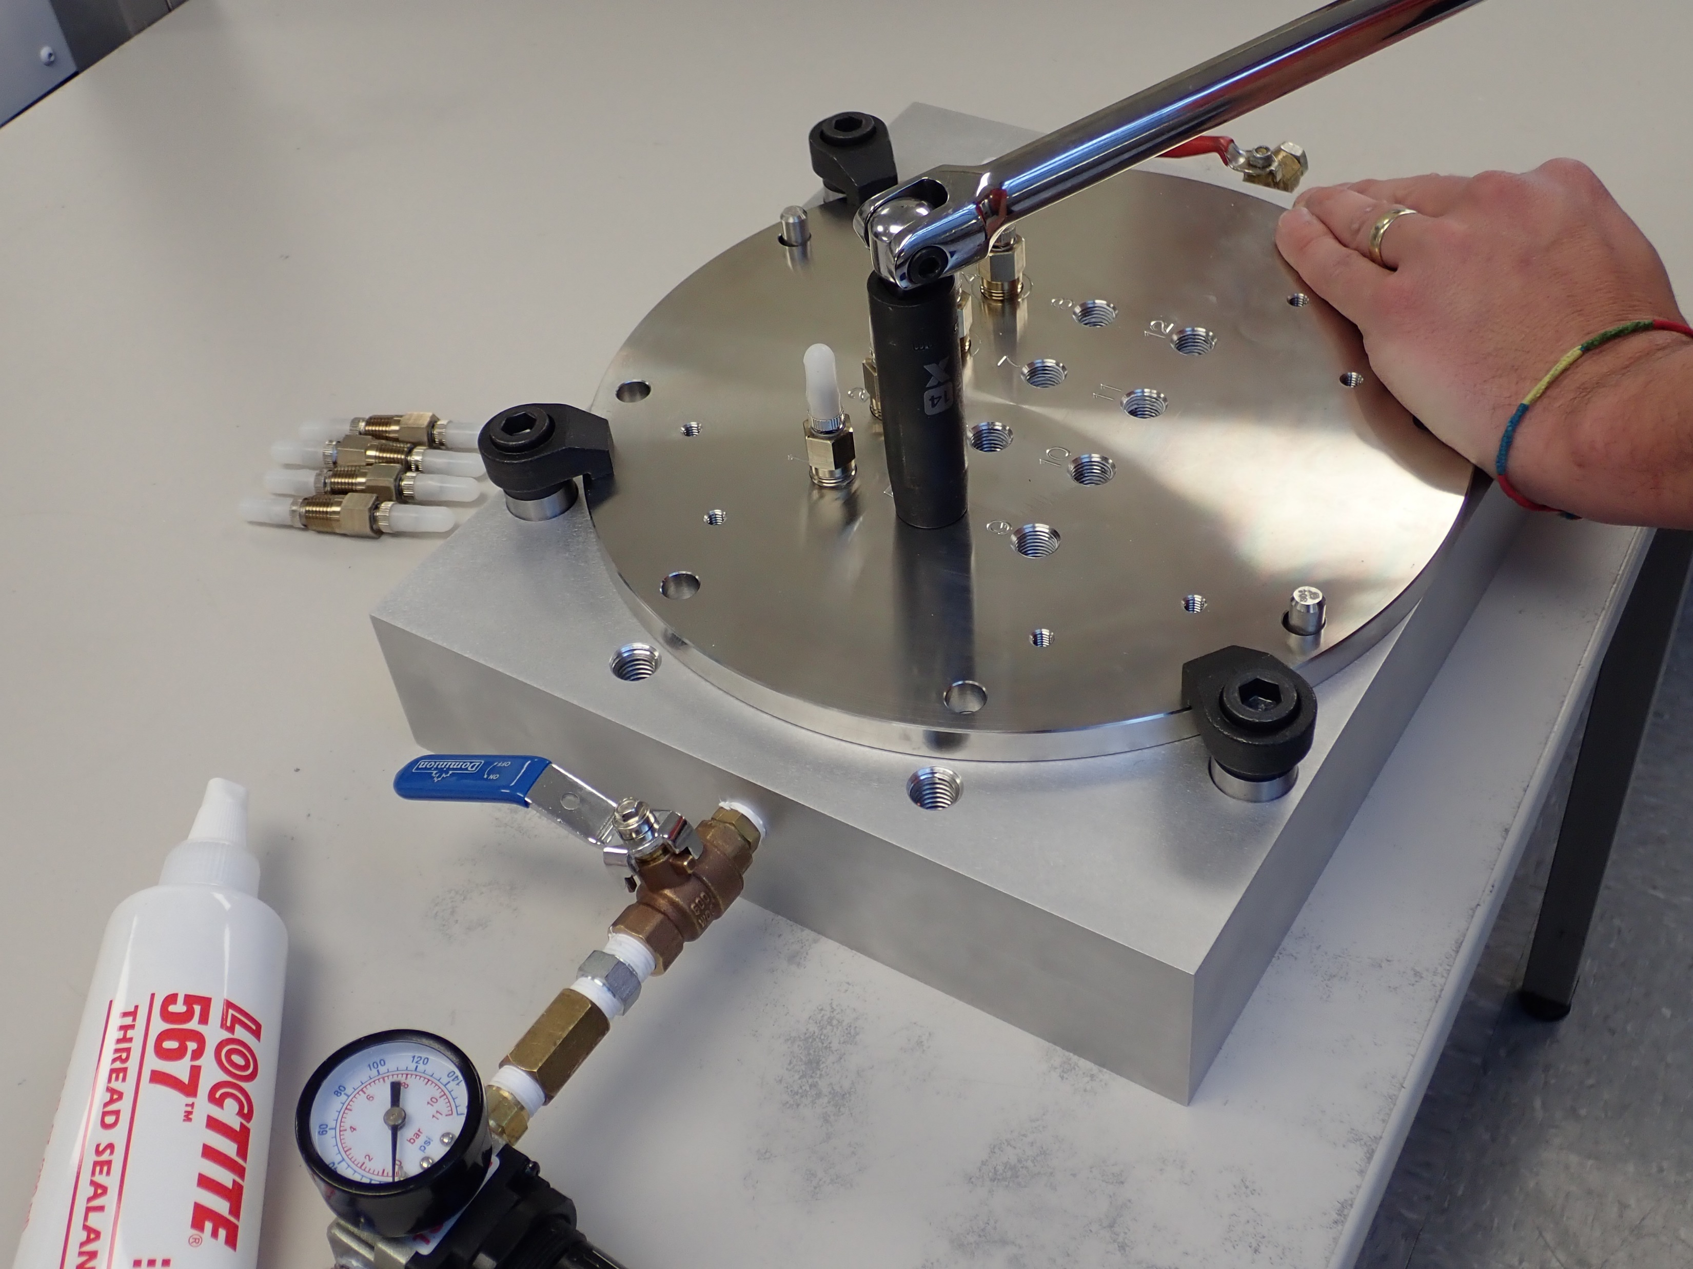
Recommendations on Feedthrough Installation
Recommendations:
Thread sealant is recommended
Loctite 567 or 3M Rite-Lok PS67 or PS92
Apply a small quantity on the feedthrough tread before screwing it to the tank wall plate
Torque by “feeling” and by number of turns
With NPT threads, it is not possible to specify a recommended torque value, so we need to go by “feeling” (just like all plumbers are doing)
The recommendation is to hand tight the feedthrough and then add ~2 turns with a wrench fitted with a 14 mm socket
You will need to apply substantial torque, especially if you are not using any sealant. A 30+ cm wrench is recommended, as shown
Before Tightening
After Tightening

Slide 44
And finally, A Big Focus On Product Quality
We use zirconia ferrules throughout
This gives connector concentricity of ~ 5 µ vs. ~ 20 to 30 µ with metal ferrules
A strong optical signal is always best
This also results in much improved corrosion and scratch resistance
Probes exhibit the strongest pulling forces in the industry
Probes exhibit the lowest PD (partial discharge, less than 2 pJ) in the industry
An Optical Integrity Check is automatically performed at power on (T301)
We use nickel plated brass connectors in our feedthroughs
This results in much improved corrosion resistance
A new Interface Box, in stainless steel throughout, guaranteed to be leak proof
Meets IP66 ratings

Slide 45
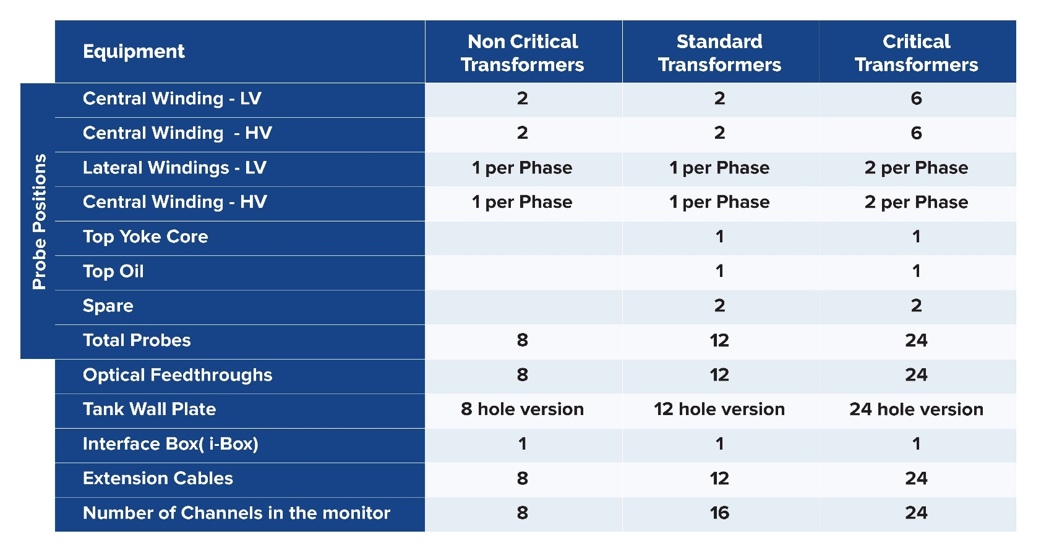
Suggested Configurations

Slide 46
Why RUGGED MONITORING?
Leading Fiber Optics Experts
Best in class response and service
Rugged Designs
Patented Technologies
Commitment to Innovation and quality
Thank you !
Questions ?
46

